Slide 1
Future Very Narrowband Radio Requirements
Implications for the
Hydrologic Warning Community
Timothy J. Salo
Salo IT Solutions, Inc.
May 11, 2011

Slide 2
Very Narrowband Implications
Topics
Narrowband Mandate and Status
Future Very Narrowband Mandate
Very Narrowband Standards
Very Narrowband Equipment
Testbed Status

Slide 3
Narrowband Mandate
Narrowband Mandate
Most Part 90 licensees must migrate to 12.5 kHz channel bandwidth by January 1, 2013
Culmination of a very long process
1995: Original narrowbanding rules adopted
1997: 12.5 kHz equipment available
2004: 2013 deadline announced

Slide 4
Narrowband Mandate
Narrowband Status
FCC appears concerned many licensees haven’t yet migrated
FCC January 26, 2011 Narrowband Workshop
Lots of interesting info
Many licensees haven’t migrated yet
Many haven’t updated licenses
Funding a concern for many

Slide 5
Narrowband Mandate
Narrowband Status
What if my cousin doesn’t migrate?
Waivers will be very difficult to obtain
FCC public answer:
Your system will not be incompliance
You won’t be legally protected from interference
You may cause interference to lawful systems
Someone might complain
Enforcement is another division…
Alleged private answer
FCC will cancel wideband licenses

Slide 6
Narrowband Mandate
Narrowband Resources
FCC January 26, 2011 Narrowband Workshop
<http://www.fcc.gov/pshs/summits/#narrowbanding_workshop>
<http://www.youtube.com/watch?v=rdV5DC5Kb7o>
FCC Narrowbanding Website
<http://www.fcc.gov/pshs/public-safety-spectrum/narrowbanding.html>
Yahoo! LMR Narrowbanding Group
<http://tech.groups.yahoo.com/group/LMR_Narrowbanding/>

Slide 7
Very Narrowband Mandate
Very narrowband, 6.25 kHz migration will occur, FCC says
No date set
FCC will follow usual rule-making processes
Note: narrowband deadline ~16 years after equipment availability
Equipment certified after January 1, 2013 must support very narrowband (6.25 kHz) operation

Slide 8
Very Narrowband Standards
Several emerging very narrowband standards
Many include data specification
dPMR (digital Private Mobile Radio)
DMR (Digital Mobile Radio)
TETRA
P25 (Project 25)

Slide 9
Very Narrowband Standards
dPMR (digital Private Mobile Radio)
European 6.25 kHz digital standard
Includes both a voice mode and a data mode
Voice products are just starting to become available in Europe
DMR (Digital Mobile Radio)
European digital standard
Multiplexes 12.5 kHz channel

Slide 10
Very Narrowband Standards
TETRA
European standard
TDMA
P25 (Project 25)
American solution for interoperable public safety radios
Phase 2 under development
Reported work on data-only mode apparently suspended

Slide 11
Very Narrowband Equipment
Some very narrowband equipment starting to become available
Proprietary data radios
Standards-based voice equipment
Icom dPMR system
Remember: Equipment certified by FCC after January 1, 2013 must support 6.25 kHz operation

Slide 12
Testbed Status
900 MHz spread spectrum radio
Digi (MaxStream) XTend
VHF narrowband radio
Maxon SD-171E with ACC 513 modem

Slide 13
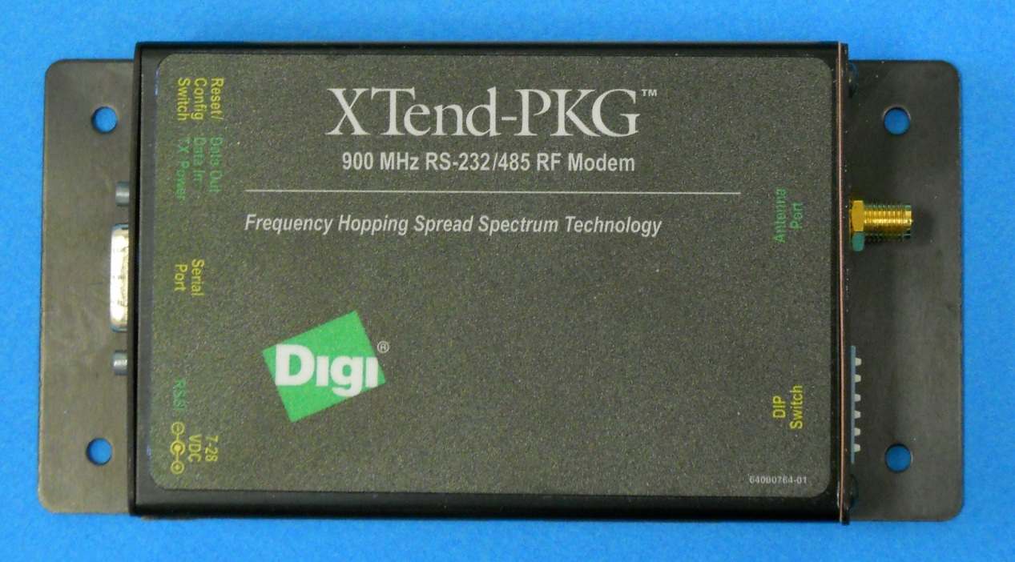
Testbed Status
900 MHz spread spectrum radio
Digi International (MaxStream) XTend

Slide 14
Testbed Status
900 MHz spread spectrum radio
Digi International (MaxStream) XTend
900 MHz unlicensed operation
1 watt transmit power
9,600/115,200 bps
Claim line-of-sight (LOS) range of 14 - 40 mile
Includes mesh networking capability

Slide 15
Testbed Status
900 MHz spread spectrum radio
Similar devices:
FreeWave FRG2-IOS
Laird (AeroComm) ConnexLink
All use different, proprietary on-the-air formats
Most ALERT / environmental monitoring vendors resell or experimenting with these radios

Slide 16
Testbed Status
900 MHz spread spectrum radio
Attempted communications over:
Five-mile non-LOS urban path
Seven-mail not-quite-LOS urban path

Slide 17
Testbed Status
900 MHz spread spectrum radio
7 dbi mobile omni
Laird MA7-7N
20”

Slide 18
Testbed Status
900 MHz spread spectrum radio
9.2 dbi omni
Comet KP-20
96”

Slide 19
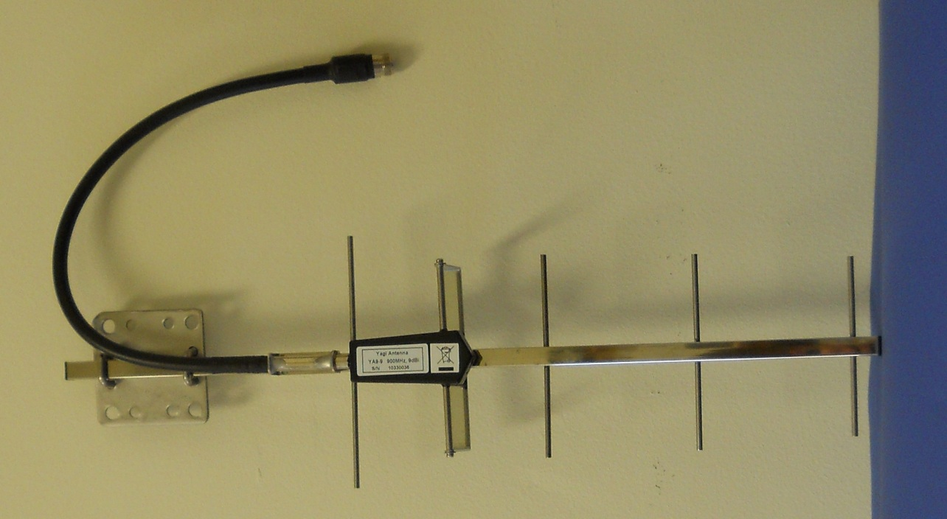
Testbed Status
900 MHz spread spectrum radio
9 dbi 5-element yagi
Laird YA9-9
20”

Slide 20
Testbed Status
900 MHz spread spectrum radio
13 dbi 15-element yagi
Laird YA9-13
57”

Slide 21
Testbed Status
900 MHz spread spectrum radio
Results
Communications never established over:
Five-mile non-LOS path
Seven-mile not-quite-LOS path
Communications established over shorter paths
Substantial interference with consumer device
Devices have potential in right circumstances
Not the solution for HWS

Slide 22
Testbed Status
VHF narrowband radio
Maxon SD-171E radio and ACC-513E modem
Narrowband (not very narrowband) VHF radio
SD-171E/ACC-513E certified for narrowband operation
Inexpensive
Commercial off-the-shelf (COTS) product
Benefits from manufacturing economies of scale
SD-171E radio: $245
ACC-513E modem: $89

Slide 23
Testbed Status
VHF narrowband radio
Maxon SD-171E radio and ACC-513E modem
Interoperates with Midland SD-171 and ACC-513
Maxon SD-171E appears to be a superior radio
Midland radio appears to be obsolete/discontinued

Slide 24
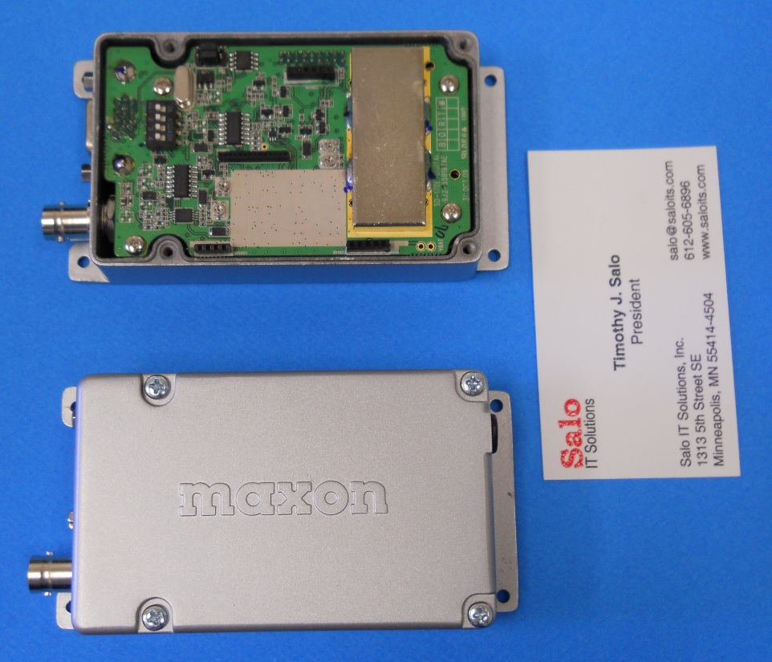
Testbed Status
VHF narrowband radio
Maxon SD-171E

Slide 25
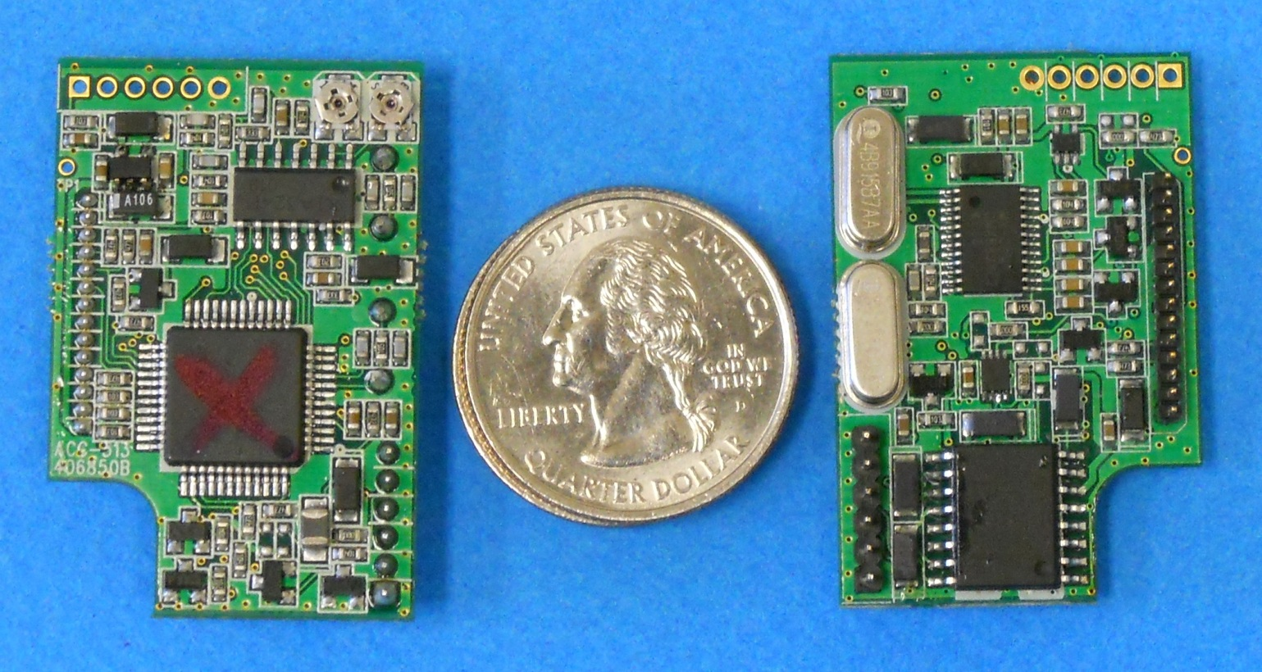
Testbed Status
VHF narrowband radio
ACC-513E modem

Slide 26
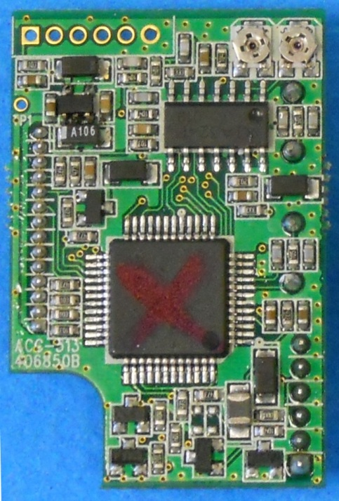
Testbed Status
VHF narrowband radio
ACC-513E modem
H8 8-bit microprocessor

Slide 27
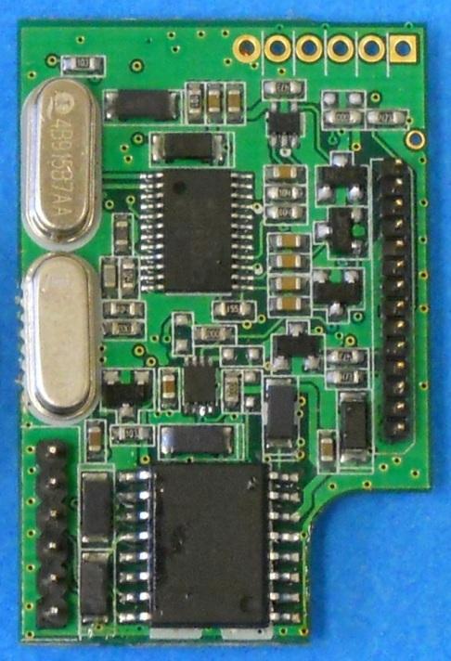
Testbed Status
VHF narrowband radio
ACC-513E modem
CML Microcircuits CMX589A GMSK modem

Slide 28
Testbed Status
VHF narrowband radio
ACC-513E modem
4,800 bps in narrowband operation
GMSK modulation
Link layer frame is based on part of MPT 1327 specification
Sort of documented in ACC-513E service manual
Is it an open protocol?

Slide 29
Testbed Status
VHF narrowband radio
Future plans:
Test and evaluate Maxon SD-171E/ACC-513E
Demonstrate interoperability with Midland SD-171/ACC-513
Maybe

Slide 30
Very Narrowband Observations
A very narrowband mandate is coming
Someday; probably not this decade
Several emerging standards offer the prospect of interoperable very narrowband data equipment
Maybe; not today

Slide 31
Very Narrowband Observations
HWS vendors and operators should make their needs known to data radio vendors
Standards-based, interoperable very narrow band data radios
dPMR data-only radio?
P25 Phase 2 data-only radio?
???
Speak with a collective voice

Slide 32
Acknowledgement / Disclaimer
This work was supported by National Oceanic and Atmospheric Administration (NOAA) National Weather Service (NWS) Office of Climate, Water and Weather Services.
The opinions expressed here are those of the author, and do not necessarily reflect those of any other individual or organization, including those that have funded, are funding, or may in the future fund the author’s employer, Salo IT Solutions, Inc.

Slide 33
Very Narrowband Implications
?

